Slide 1

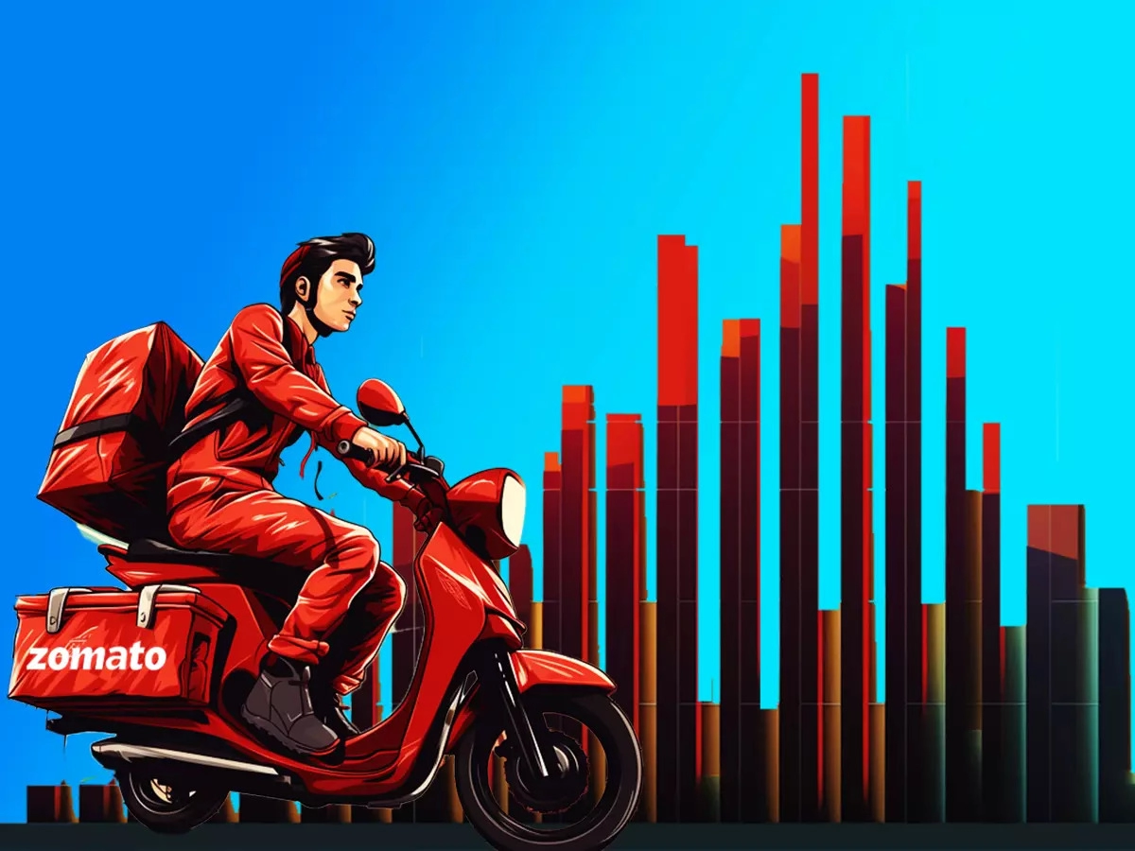
ZOMATO RESTAURANTS ANALYSIS
Roopam Srivastava
18/02/2024

Slide 2
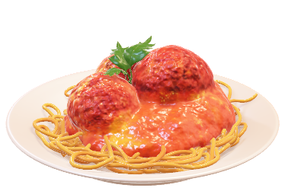
INTRODUCTION
INTRODUCTION
Zomato is an Indian multinational restaurant aggregator and food delivery company. It was founded by Deepinder Goyal and Pankaj Chaddah in 2008 who earlier worked in Bain & Company. The website started as a restaurant-listing-and-recommendation portal. It provides information, menus and user-reviews of restaurants as well as food delivery options from partner restaurants in more than1,000 Indian cities and towns.
The Zomato was formerly known as Foodiebay (2008-10). It’s headquarter is located in Gurugram, Haryana, India. The revenue of the company is around ₹7,079 crore which is around US$890 million in current time. The subsidiaries are Blinkit and Hyperpure. Its official website is www.zomato.com.
In December 2018, Zomato launched its annual multi-city food and entertainment carnival called Zomaland. In March 2019, Zomato sold its UAE food delivery business to Talabat.In June 2023, Zomato launched a feature that enabled users to build carts from up to four restaurants and place the orders together. In October 2023, the company started offering hyperlocal package delivery service on a separate app called Xtreme.

Slide 3


INTRODUCTION (cont…)
FUN FACTS ABOUT ZOMATO
The food delivery app operates in 24 countries with10,000 cities globally.
The most ordered dish on Zomato is “Biryani”, in the pandemic 2020, 44 lakhs+ orders were placed for Biryani.
During the Pandemic in 2020, Zomato delivered amount 22 Biryanis every minute.
On average Zomato gets 12.5 lakh orders daily.
The most expensive order placed on Zomato costs nearly Rs. 2 Lakh.
Zomato IPO is one of the biggest IPO by the startup in India.

Slide 4
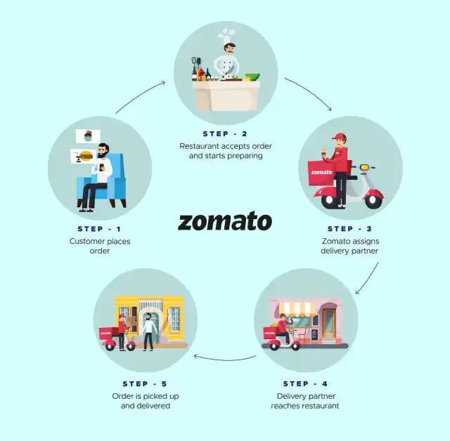
WORKFLOW OF ZOMATO
As the above picture shown this is how the Zomato works. The processing of food delivery begins from the customer’s place where he/she orders food from its device. Later on, its forwarded to restaurant where they accept the order and starts preparing. Meanwhile the order is being prepared the Zomato assigns the delivery partner for the ongoing order process. Then in the last part of the process the Delivery partner pickups the food from the restaurant and drops the package to the customer within the allotted time slots.

Slide 5
INSIGHTS OF PROJECT ANALYSIS
The basic objective of the project is to analyze the data to get an output of how a company can increase its market in the already serving area and can open new restaurants in the new area or an existing area. The data we received is from the Zomato company itself.
The tools which have been used to determine the following analysis are VLOOKUP, If functions, AVERAGE, SUM, PIVOTS, and CHARTS.

Slide 6
ANALYSIS
The given data is provided by the Zomato company. From the given data there were few observations made. The following data consists of things which plays an important role in analysis of opening new resataurants in the given or new countries.
The observations are as follows:
There were 2 tables in two sheet: (1) RAW DATA & (2) CountryDescritpion
2. TOTAL ATTRIBUTES PRESENT: 20 attributes present in the raw data.
3 more attributes were added in the raw data using different formulas. So, in total there are 23 attributes in data.
3. The data includes the categorical information. In the provided data there are about 8 categorical data which includes Country name, Cuisine, Currencies, etc.
4. There were some missing values in the cuisine column which I replaced it manually with the highest number of cuisine in the world category. Then there were some data issue in the city name as Sao Paulo and Istanbul was written incorrectly as Sí£o Paulo and UAstanbul respectively by find and replace function in MS Excel.

Slide 7
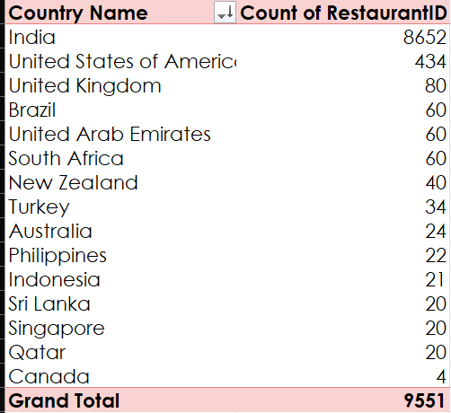
ANALYSIS( Cont…)
The given data consist of list of restaurants that are opened by Zomato in the different countries during the time range of 2010 to 2018. thus from the given data it can be seen that there are total 15 countries where Zomato has opened restaurants in time period of 8 years.
The top 5 countries with highest number of restaurant opened by Zomato are as follows:
India
United States of America
United Kingdom
Brazil
United Arab Emirates
Thus, among all the countries the Canada has the least numbers of restaurants with a count of 4 restaurants.

Slide 8
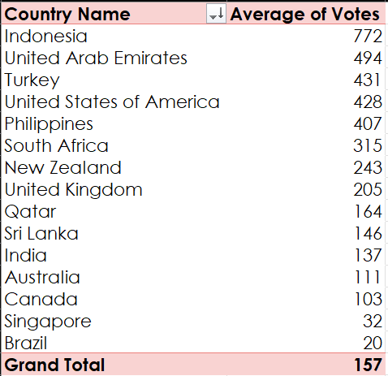
ANALYSIS( Cont…)
The given table shows the average number of voters in different countries which is the most useful attribute in the analysis of my project.
TOP 5 VOTERS:
1. Indonesia 772 voters
2. United Arab Emirates 494 voters
3. Turkey 431 voters
4. U.S.A. 428 voters
5. Philippines 407 voters
While the Brazil has the lowest average number of voters which is only 20

Slide 9
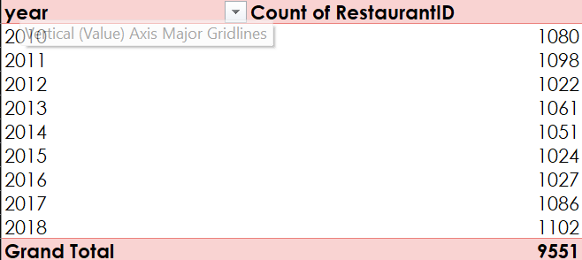
ANALYSIS( Cont…)
Total 9551 restaurants were opened by Zomato in total 15 countries in time period of 2010-2018.
The maximum number of restaurants were opened in the year 2018.
While the least number of restaurants were opened in the year 2012.

Slide 10
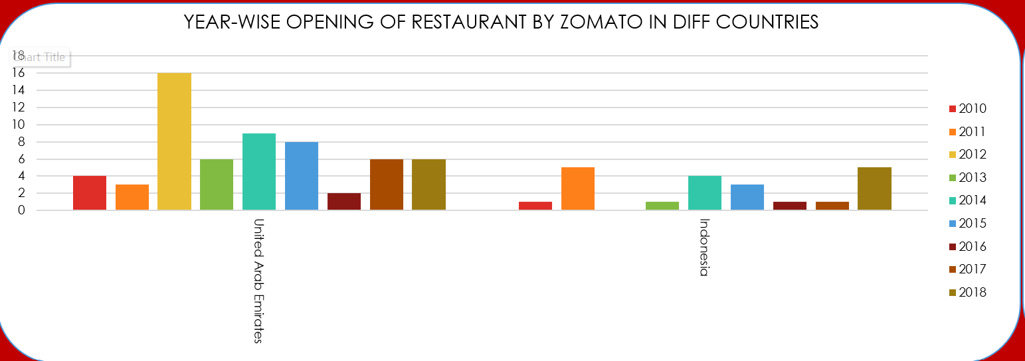
ANALYSIS( Cont…)
According to the data provided. These are the different observations made by me with respect to the average number of restaurants and rating.
The few countries I would suggest to open newer restaurants with lesser competition are Indonesia and United Arab Emirates. Because both the countries have maximum number of ratings as compared to all other nations as their average are something near to 4.30 and 4.23 respectively with 16214 and 29611 votes respectively.

Slide 11
ANALYSIS( Cont…)
Below observations are about the cities I would recommend to open the new restaurants in the suggested countries based on the average ratings with respect to average number of voters.
INDONESIA: In total there are 4 cities that are currently having restaurants that are operated by Zomato that are Bogor, Tangerang, Jakarta and Bandung. The maximum number of restaurants are mostly concentrated in Jakarta. So, opening a new restaurant I would recommend would be the Tangerang and Bandung, as the rating around these cities is high with a smaller number of choices so would recommend to open more new restaurants.
UNITED ARAB EMIRATES: Likewise, Indonesia there only 3 cities that are served by Zomato in UAE that are Sharjah, Abu Dhabi and Dubai. The distributions of the restaurants in these 3 cities are even as each cities have 20 restaurants each. Still I would recommend the city in which restaurant should be open is Sharjah as there are no restaurants that provide online delivery and table booking.

Slide 12
ANALYSIS( Cont…)
City | Count of RestaurantID | Average of Rating
Abu Dhabi | 20 | 4.3
Dubai | 20 | 4.37
Sharjah | 20 | 4.03
Grand Total | 60 | 4.233333333
City | Count of RestaurantID | Average of Rating
Bandung | 1 | 4.2
Bogor | 2 | 3.85
Jakarta | 16 | 4.35625
Tangerang | 2 | 4.3
Grand Total | 21 | 4.295238095
The current quality regarding ratings for restaurants that are open there is 4.30 and 4.23 in Indonesia and UAE respectively. Though very a smaller number of restaurants have extra facilities that are provided by the restaurant. As the demand of food is high over there, the new restaurants will have great response.

Slide 13
ANALYSIS( Cont…)
The total expenditure of the suggested cities are as follows: In Indonesia the average cost of two people is around 281190.28 IDR. The price range of the two is from about 70000 IDR to maximum of 800000 IDR. Same as Indonesia, in United Arab Emirates the average cost of two people is around 166.42 AED. While its price ranges from around 50 AED to maximum of 250 AED.
City | Average of Average_Cost_for_two
Bandung | 150000.00 IDR
Bogor | 160000.00 IDR
Jakarta | 308437.50 IDR
Tangerang | 250000.00 IDR
Grand Total | 281190.48 IDR
City | Average of Average_Cost_for_two
Abu Dhabi | 182.00 AED
Dubai | 211.75 AED
Sharjah | 105.50 AED
Grand Total | 166.42 AED

Slide 14
ANALYSIS( Cont…)
The Talaga Sampireun and Sushi Masa can be our biggest competition as they have the highest ratings among all the restaurants available there as its rating is around 4.9 and 4.6 respectively despite having no extra facilities provided by them. These restaurants are ranging in 2-3 price range. While in UAE, the AB’s Absolute Barbeque and Punjab Grill can be a tough competition as its rating ranges from 4.8-4.9 and 4.9 respectively. While both the restaurants provide online table booking options. The price range of both the restaurant is in 3 and 4 respectively.
According to our current data, we should definitely go with online delivery and table booking features. As this affects the rating of the restaurants, it can be seen that the restaurants that provide these facilities has more ratings as compared to the restaurants that don’t provide such facilities.
Has_Online_delivery | Average of Rating
No | 2.754309859
Yes | 3.288004896
Has_Table_booking | Average of Rating
No | 2.809686644
Yes | 3.482556131

Slide 15
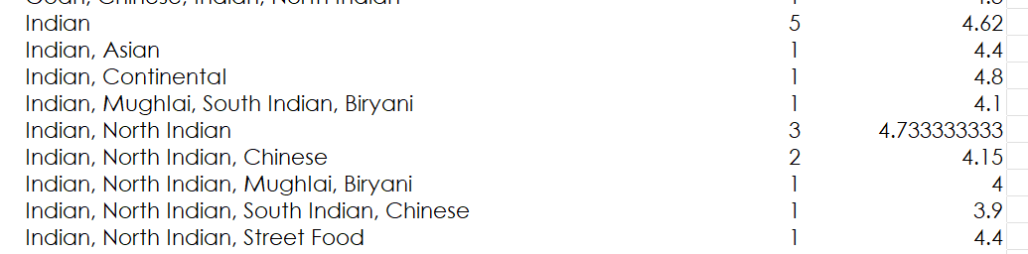
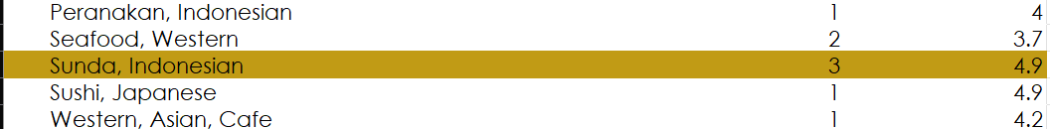
ANALYSIS( Cont…)
FOR U.A.E.:
The cuisine plays a big role in the ratings of the restaurants. In UAE, the Indian cuisine is more popular than the other cuisine which is mostly North Indian or Rajasthani cuisine. Which is followed by American or fast-food cuisines. From the table it can be seen that there are total 16 restaurants serving north Indian cuisine ands its average rating ranges from 4.6-3.9. Which show its relation between cuisine and rating.
FOR INDONESIA:
While in the Indonesia the most popular cuisines are Sunda, Indonesian and Sushi. The maximum number of restaurants which serves Sunda, Indonesian and Sushi. And these were the top most rated among the total cuisine served in the areas.

Slide 16
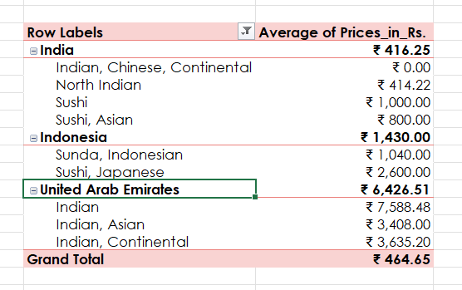
ANALYSIS( Cont…)
As per my observations in the data. The rate of cuisines cannot be increased because no correlation can be found regarding the rating and cuisine in the given data as its highly dynamic, as we can see some restaurants having same cuisine have different price range. So, in my opinion the price should be increased according to the facilities and other criteria. And it can also be seen that same cuisine having low price range have better rating. We can se that the rate of Indian cuisine is highly variated in U.A.E as compared to India.

Slide 17
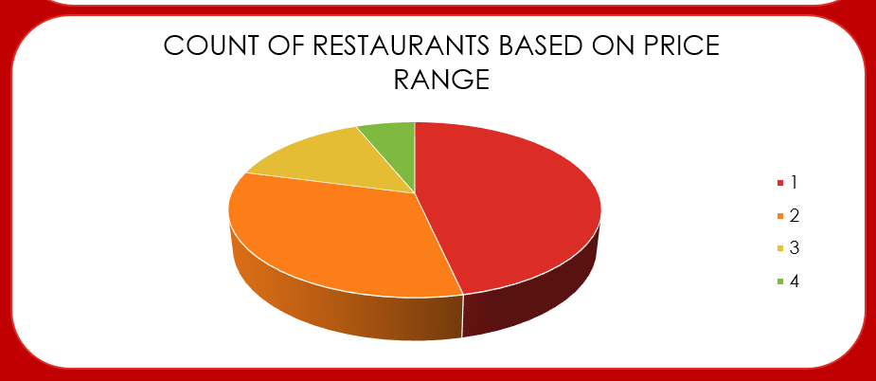
ANALYSIS( Cont…)
The distribution of the number of restaurants of different price ranges in all countries is highly variated. As the number with price range 1 has the maximum number of restaurants that is 4444, while there are only 586 restaurants in the price range of 4.
Price Range | Count of RestaurantID
1 | 4444
2 | 3113
3 | 1408
4 | 586

Slide 18
The below statement is the approach in brief which I used for suggesting countries/cities in order to open new restaurants. The approach I used to provide the suggestions for opening a new restaurant is the number of people involved in rating the food.
The second thing I kept in my mind was the country with highest rating with respect to the number of votes, which shows that there is a greater number of peoples as compared to restaurants.
As mentioned above the number of people is more than the number of restaurants thus adding a new restaurant will draw more people to new restaurant along with the old customer if the food quality is maintained.
As also seen in the suggested countries or cities it can be seen that most of the restaurants didn’t have extra facilities thus opening a new restaurant with these facilities will draw more people which will lead to more customers.
It can also be seen that price range of food here in these countries is very high thus it will lead to have the good rate compared to other.
Thus, this was my observation with respect to the provided data, I believe a new restaurant in the Indonesia and UAE will help in improving the current situation without applying high infrastructure.

Slide 19
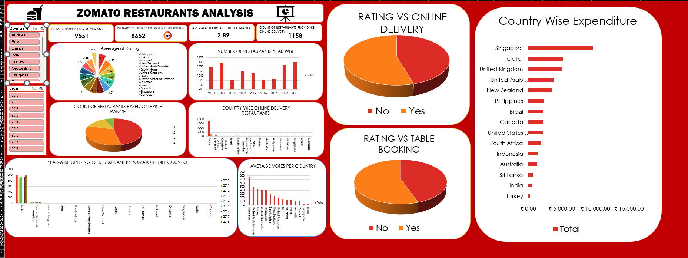
DASHBOARD

Slide 20
REFERENCES
1 . https://bootcamp.uxdesign.cc/metrics-to-track-the-success-of-zomato-food-delivery-platform-dd618fe8e211: medium
2. https://www.linkedin.com/pulse/14-interesting-facts-zomato-you-didnt-know-priyanka-singh--dc4vf: linkedin
3. https://en.wikipedia.org/wiki/Zomato: Wikipedia

Slide 21
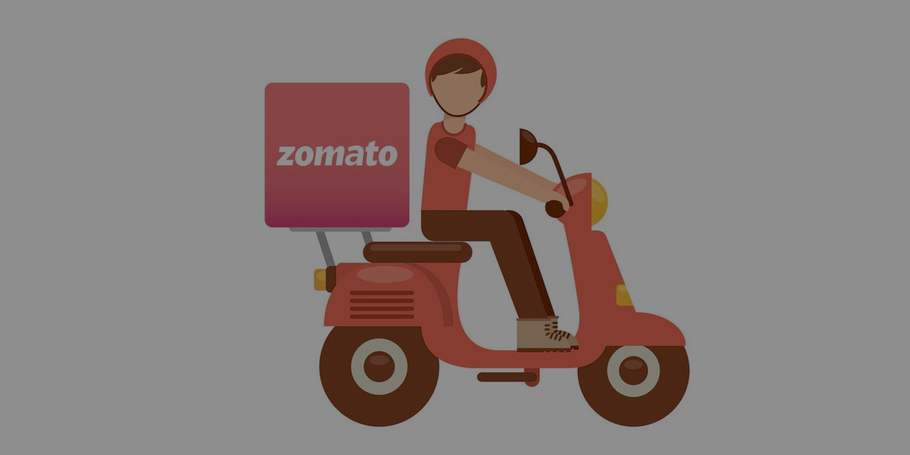

THANK YOU

